Slide 1

Stage 5 Another Day on an Oil Rig Course Designer: Kevin Wang
Another Day on an Oil Rig is a 19 round, 95 point Comstock Medium course. There are 7 USPSA targets and 5 steel targets. The best two hits per target will score. Steel must fall to score. The start signal is audible.
The Handgun start position is standing with hands touching top marks. Handgun loaded and holstered. The PCC start position is standing with PCC loaded and muzzle touching lower mark, stock on belt, safety on.
On the audible start signal, engage all targets from within the shooting areas. Stomp paddle activates swinger 1 which remains visible at rest.

Slide 2
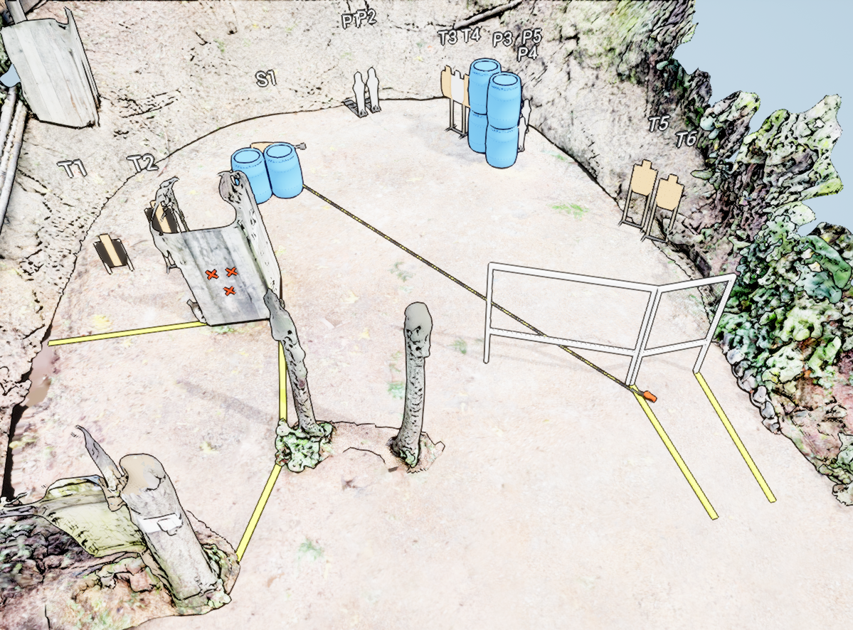
 | Stage 5 Another Day on an Oil Rig Course Designer: Kevin Wang

